Slide 1
NLP for Ethical Predictions - Can we use NLP to examine morality ?
Data Scientist – Tri Nguyen

Slide 2
What is morality ? What is ethics?
The age old question meets new age approach
The Process
Scrape the web for data using – api.pushshift.io
Preprocess and examination of data set
Modeling for best fit and score
The Dataset
2 Reddit Subreddits
LifeProTips
UnethicalLifeProtips
The Expectation
Using NLP and modeling from the data set we can predict whether a given advice

Slide 3
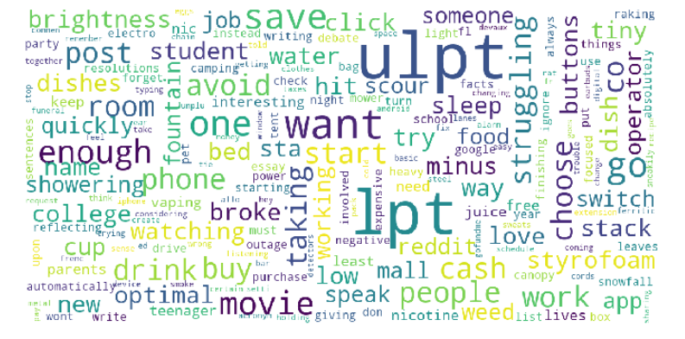
The Data

Slide 4
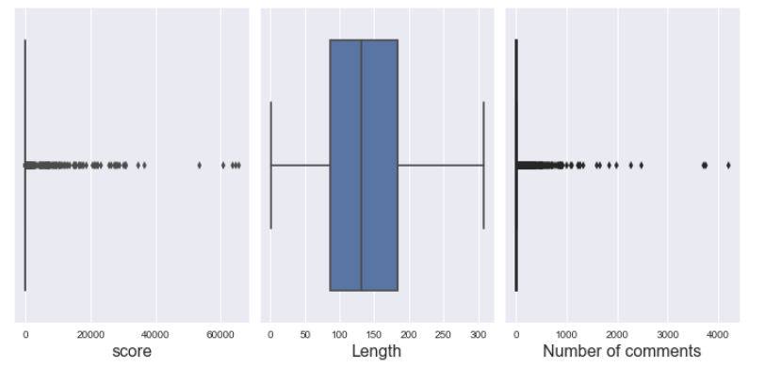
The Data Overall

Slide 5
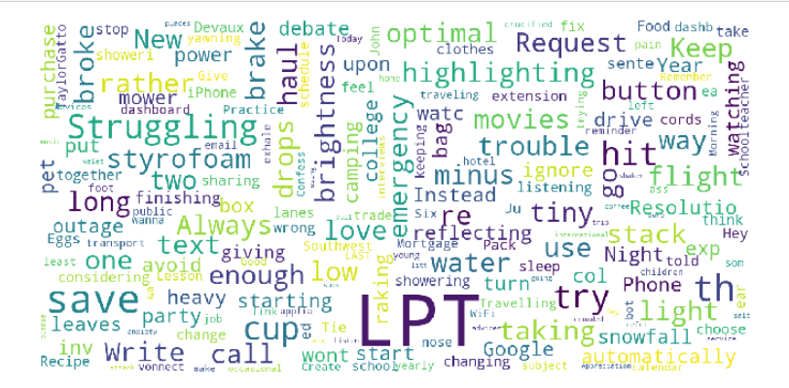
The DATA - LifeProTips

Slide 6
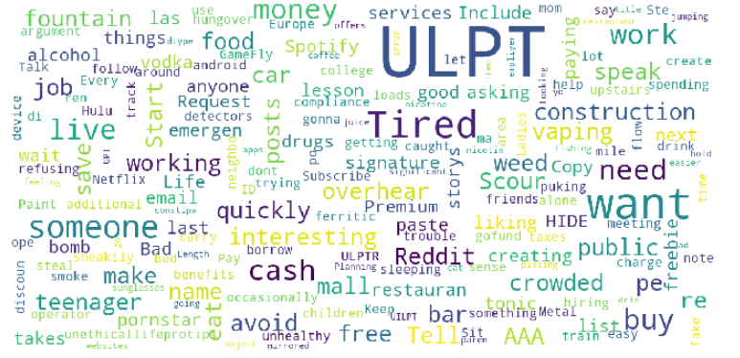
The Data – Unethical LifeProTips

Slide 7
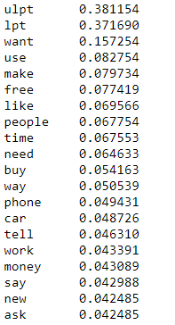
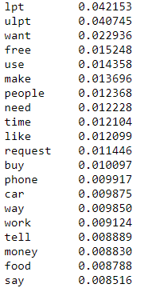
Top Words
TfidfVectorizer
CountVectorizer
When Cleaning the data
No Stemming or Lemming
Ensure accurate depiction or real vernacular
CountVectorizer and TfidfVectorizer Comparison
Different mean values of words
Different order

Slide 8
Lets Look at the Code!
Logistic Regression and RandomForrest

Slide 9
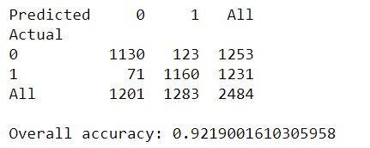
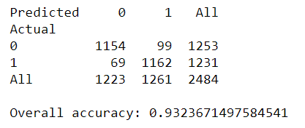
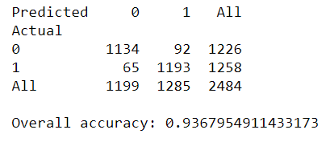
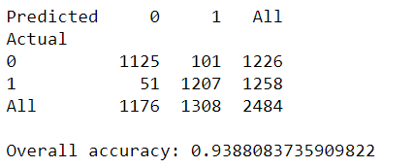
The Numbers
Logistic Regression
Random Forrest
CountVectorizer
CountVectorizer
TfidfVectorizer
TfidfVectorizer

Slide 10
Conclusion
There is predictive power in NLP in determine ethical advice
Only limited to specific subreddit
Removal of ULPT and LPT reduces the score but it still better than baseline
Limitations in current modeling and predictive power.
There will come a day…one day

Slide 11
Top Post, you determine it!
LifeProTips
UnethicalLifeProTips
Pay Attention to the smell of your home when you come back from a trip - that's what it smells like to guests all the time, you just get used to it.
Don't let people guilt you for not visiting them. They're not visiting you either.
Save business cards of people you don't like. If you ever hit a parked car accidentally, just write "sorry" on the back and leave it on the windshield.
If you ever get caught sleeping at your desk at work then say "They told me at the Blood Bank that this would happen" when asked for a reason

